Slide 1
ONLINE MEDICAL APPOINTMENT
Presented by
Leelamrutha Vanamu

Slide 2


INTRODUCTION
Online medical appointment refers to the process of booking and scheduling a medical consultation or appointment with a healthcare professional through a digital platform.

Slide 3

Benefits
Convenience
Time saving
- reduced waiting time
Advantage for the staff
- reduces burdensome administrative tasks for staff

Slide 4


tkinter
MySQL
Tkinter is used to develop graphical user interface (GUI)
Storing data in MySQL database

Slide 5
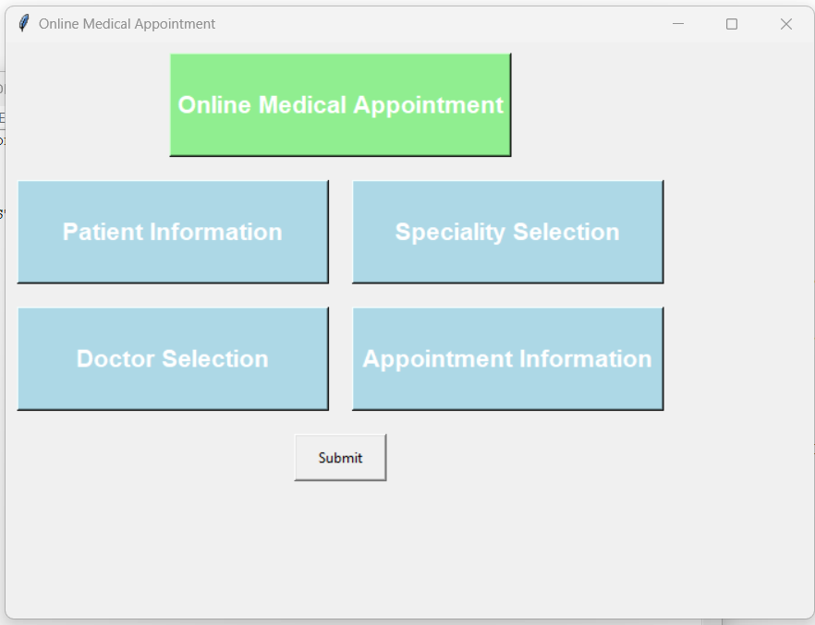
OUTPUT

Slide 6
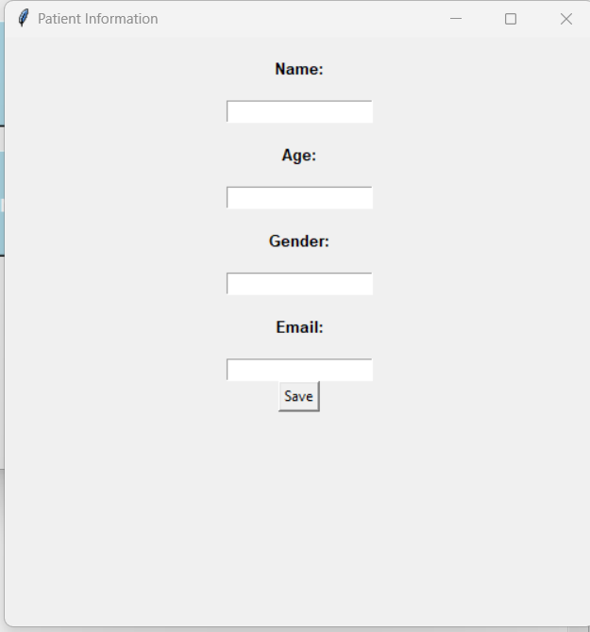
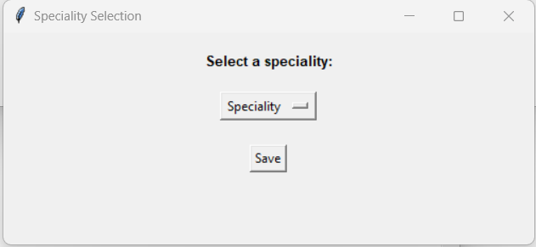

Slide 7
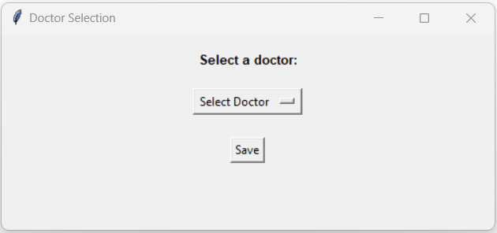
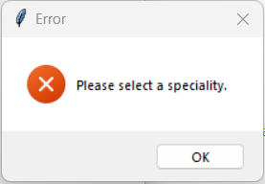

Slide 8
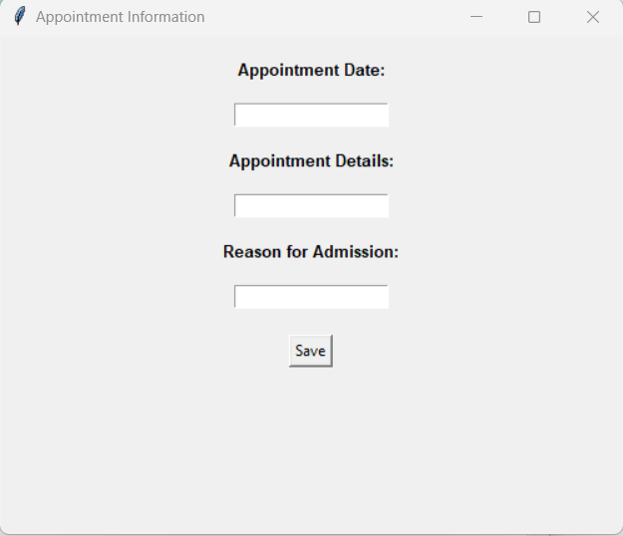
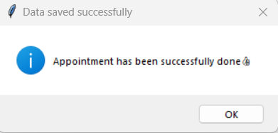

Slide 9
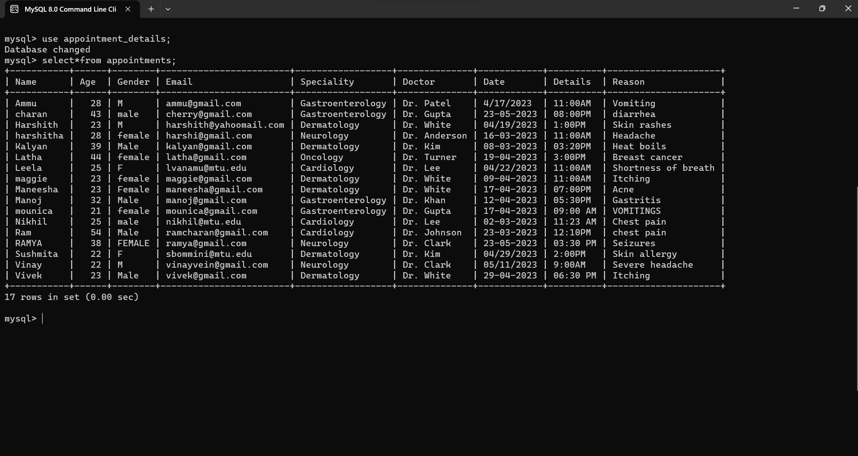

Slide 10


